Slide 1
Threads and Processes

Slide 2
Overview
Threads
Address space
Processes
OS-level process state

Slide 3
Program
A program is a static file containing instructions + data
Describes how to perform a computation
When a program is run, OS maintains state for the various abstractions its provides to the running program
Thread (CPU) state
Holds registers, PC, SP, etc.
Address space (memory) state
Holds program instructions, static and dynamic data values
Device and other state
Holds state such as open files, network connection state, etc.

Slide 4
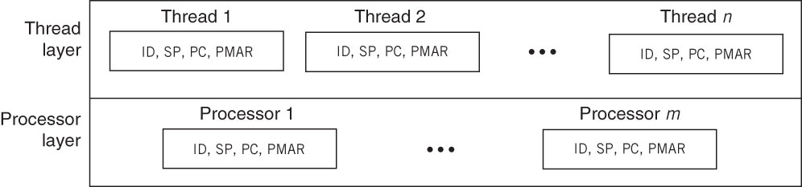
Threads
OS abstraction for virtualizing the CPU
Each thread runs on CPU, thinks it has its own set of CPU registers, unaware of other threads
# of threads is arbitrary, # of CPUs is fixed
Implemented by multiplexing thread instruction streams
C
C
B
B
A
A
Time, uniprocessor
Time, dual processor
Notes:
Implemented: multiplexing == interleaving the thread instruction streams on one or more CPUs.
Note that on a dual CPU, threads execute truly in parallel.

Slide 5
Comparing Functions with Threads
Functions
Threads (on single CPU)
F1
F2
T1
T2
switch
F1 calls
F2
suspend
resume
switch
stream of instructions
F2 runs to
completion
suspend
resume
switch
F2 returns
to F1
Notes:
Functions:
1. have a stack (LIFO) discipline. F1 calls F2. Until F2 completes, F1 will not run. As a result, they run on a single stack.
2. Notice that F1 explicitly calls F2.
3. Multiprocessor: Even if F2 ran on a different processor, we could not run F1 and F2 in parallel because of the stacked calls.
Threads:
Threads are independent streams of execution. They are unaware of each other and run independently of each other. Notice that T2 doesn’t have to finish before T1 can resume. Each thread calls its own set of functions. As a result, each thread needs its own stack.
Notice that T1 doesn’t call T2 or the other way around. Instead, a thread scheduler multiplexes the threads on the CPU by switching between them.
Multiprocessor: The picture shown for T1 and T2 would apply to each CPU. E.g., T3 and T4 would be switching on CPU 2.

Slide 6
Benefits of Threads
Allow running multiple programs concurrently
Allow a program to run multiple tasks concurrently
Help hide I/O latency: if one thread has to wait on I/O, then another thread can run while the first thread blocks
E.g., a web server could use a thread to receive a request, read a file and send it
How would you implement this functionality without threads?
Hiding I/O latency: have we seen this before?
With multiple CPUs, tasks can be run truly in parallel
E.g., a parallel matrix multiple program
Notes:
Concurrency = running at the same time
Without threads, the problem is that while a file is being read from disk (which is slow), another request that has arrived cannot be processed. The way to deal with this without threads is to use non-blocking file IO, where the program issues a file read, but doesn’t block if the file is not in memory. Then it periodically checks whether the file is in memory, while still operating on other requests. This kind of programming is called event-driven programming, and it is hard to get right, because one needs to build a state machine, that tracks the status of each request. Threads essentially simplify all of this, because each thread implicitly maintains the state of a request.
Have we seen this before: yes, with interrupts, the CPU could be used concurrently, while the disk controller was reading data from disk.

Slide 7
Address Space
An address space is the set of (virtual) memory regions accessible to a program
Text – the program code (usually read only)
Data, heap – static, dynamic variables
Stack – used for function and system calls
OS abstraction for virtualizing memory
Each running program has its own address space
stack
stack
SP
SP
Address space
data
data
PC
PC
text
text
Notes:
If the same program is run multiple times, the OS will still create separate address spaces for the different instances, so that each can run independently of the others.

Slide 8
Review of Program Data
Type of variable determines size and alignment of memory
A program variable is a symbolic name
for some data stored in memory
int var;
int * p = &var;
Address of variable is the index of memory "array" where data is stored, e.g., if data is stored at memory[i], then address is i, value of variable is the contents of memory[i]
Pointer is a variable whose value is a memory location, e.g., value of pointer variable is i, dereferencing pointer gives memory[i]

Slide 9
Review of Program Execution
int a = 5;
int main(int r)
{
int b = 10, c;
c = f(b+c);
}
int f(int x)
{
int y = x;
return y;
}
r
parameter of main()
ret val
return value of main()
ret addr
address where main() will return
activation frame of main()
prev fp
fp (frame ptr)
other regs
b
pc
c
sp (stack ptr)
a = 5;
data (globals, heap)
main(), f()
text (code)
Notes:
The exact locations of parameters, locals, return address, etc., in the activation frame depends on hardware, compiler, compiler options, etc.
In example above, the order is parameters, return val & addr, frame pointer, locals (prfl or powerful)
fp is used to access the stack variables

Slide 10
Function Call and Return
int a = 5;
int main(int r)
{
int b = 10, c;
c = f(b+c);
}
int f(int x)
{
int y = x;
return y;
}
r
ret val
activation frame of main()
ret addr
prev fp
other regs
b
c
x = b+c
parameter of f()
ret value
return value of f()
activation frame of f()
ret addr
address in main() to return to
prev fp
fp (frame ptr)
other regs
y
sp (stack ptr)
pc
a = 5;
data (globals, heap)
main(), f()
text (code)
Notes:
on function call:
push fp // the fp value in main() is saved in prev fp in f()
fp = sp // this helps track the sp value at the start of the function
the result is that the set of prev fp in the previous activation frames form a link list of previous stack pointer values, so that on function return we can figure out the location of the activation frame of the caller function (see below)
on function return, the reverse happens:
sp = fp
pop fp // fp is assigned to prev fp (%fp = *%fp)
// now the stack pointer points to the ret address, and the ret instruction jumps back to the caller using the ret addr
// the caller then pulls out the return value from the stack pointer, and then pops the arguments it had pushed on the stack for the callee.
// at this point, the stack pointer points to the location before the callee was invoked.
show demo of function f() in code-examples/intro/read.c with a debugger.

Slide 11
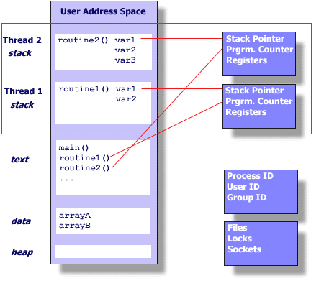
Process
A running program consists of one or more processes
Traditionally:
process = address space + thread
Address space provides memory protection
Thread enables concurrency
Communicate using system calls
Today:
process = address space, with one or more threads
Threads share address space
E.g., threads share data (e.g., arrayA), code, but don’t share stack
Communicate with reading/writing memory
Notes:
The core abstractions are threads and address spaces. Researchers realized that a process, consisting of one address space and one thread was limiting. For example, if two threads wished to communicate, they could only do so using system calls, which is expensive. Allowing multiple threads within an address space allowed these threads to communicate using memory read and write very efficiently. This also separates the notions of protection from concurrency. Previously, in order to get concurrency, one needed to have a separate memory protection domain (separate address space). With the new definition of a process, the process provides protection, but enables concurrency within the protection domain.

Slide 12
How to Speedup Vector Operation
How would you speedup this program?
Using multiple processes
Using threads in a single process
Would there be any speedup on a single processor?
How is the speedup achieved?
Would there be any speedup on a multiprocessor?
How is the speedup achieved?
E.g., client-server program
One process for server + one process per client
Server may run using multiple threads
Threads communicate using shared address space
Useful when threads cooperate heavily, e.g., server cache
Processes communicate using buffers (e.g., files)
Provides isolation, e.g., browser tabs
Benefits of using threads vs. separate processes
Faster communication by reading/writing memory
Lower memory needs because address space is shared
Faster because thread switching doesn’t require switching address space
For (k = 0; k < n; k++)
a[k] = b[k] * c[k] + d[k] * e[k];
Notes:
Using say 2 processes: we could have one process contain the b and c array, and the other process contain the d and e. These two processes could run in parallel, and calculate b*c and d*e. However, then we need to add b*c with d*e, and assign to a. All of this communication would have to happen via system calls, since the two processes do not share any memory.
With 2 threads in a single process, the adding of b*c and d*e, and assigning to a would be memory operations, because threads share memory.
Speedup on single processor: no, because the speedup depends on true parallelism, which doesn’t exist on a single processor. In fact, there would be a slight slowdown, because as we will see later, the OS will be switching between processes, which takes some time.
Speedup on multi-processor: yes, the two CPUs will run the two threads in parallel.

Slide 13
How to Speedup Web Server Program
How would you speedup this program?
Using multiple processes
Using threads in a single process
Would there be any speedup on a single processor?
How is the speedup achieved?
Would there be any speedup on a multiprocessor?
How is the speedup achieved?
E.g., client-server program
One process for server + one process per client
Server may run using multiple threads
Threads communicate using shared address space
Useful when threads cooperate heavily, e.g., server cache
Processes communicate using buffers (e.g., files)
Provides isolation, e.g., browser tabs
Benefits of using threads vs. separate processes
Faster communication by reading/writing memory
Lower memory needs because address space is shared
Faster because thread switching doesn’t require switching address space
Run in loop:
1. get network message (URL) from client
2. get URL data from disk, cache in memory
3. compose response
4. send response
Notes:
Unlike in the previous example, here steps 1 and 4 access the network, and step 2 accesses the disk. These are IO intensive operations, during which time the CPU will remain idle.
Using say 2 processes: We can run two loops, one in each process. The main problem is that if there is a request for the same file again, and the file is cached in process 1, but process 2 serves the second request, then the file in process 1’s cache cannot be used, because process 2 cannot access process 1’s memory.
With 2 threads in a single process: The two threads can access the shared file cache.
Speedup on single processor: yes possible, with process or threads, because while one loop is waiting for IO, the other can use the processor. So, unlike in the previous example, speedup is possible here with one processor because threads allow exploiting concurrency between the processor and IO devices. (In the previous example, the process was only using the CPU, so more than one CPU was needed to get speedup).
Speedup on multi-processor: yes, the two CPUs will run the two threads/processes in parallel.

Slide 14
Threads versus Processes
 | Threads | Processes
Memory needed | Shared, less | Not shared, more
Communication & Synchronization | Via shared variables, faster | Via system calls, slower
Switching | Faster | Slower
Robustness | Memory sharing can cause hard-to-detect bugs | All communication is explicit, more robust program design
Notes:
Communication and synchronization: threads communicate and synchronize with each other by reading/writing memory locations, which is very efficient. Processes can only communicate by using system calls (via calls to OS), because they do not share memory, so communication is slower.
Switching: As we will see later, switching an address space (for a process) requires updating the MMU registers (e.g., base and limit). Today, MMUs are more complicated than the simple MMU we have discussed, and updating their registers has a significant impact on performance.

Slide 15
OS-level Process State
OS keeps state for each process
Called process state, process control block (PCB), etc.
The per-process state consists of
Thread state (for one or more threads)
Processor registers, allows resuming a suspended thread
Thread id, uniquely identifies thread
Various parameters, e.g., scheduling parameters
Address space state
Location of text, data, stack regions
MMU virtual memory state, i.e., virtual -> physical mapping
Device related state
Open files, network connections
What other state must the OS keep?
Notes:
device state such as terminal state, pending signals, timers, swap, essentially state for all per-process OS abstractions
The process state is kept by the OS and is not visible or modifiable by programs. If this state could be modified by programs, then the OS would not be able to maintain isolation. Think why.

Slide 16
Summary
A running program is called a process
OS maintains per-process state for each abstraction it provides to a process
Thread state (virtualizes CPU)
Enables running multiple threads/streams of execution concurrently
Address space state (virtualizes memory)
Enables running multiple programs with “private” memory
Device related state
Includes file state, socket state, etc.

Slide 17
Think Time
What is the difference between a program and a process?
What is the difference between a thread and a process?
What is the difference between an address space and a process?
Is the OS code run in a separate process? a separate thread? Does it need a process structure?
What is the address space of an OS?
Notes:
Diff between program and process: program is a set of instructions and data, contained in a file, process is a program loaded in memory, that is executing.
Diff between thread and process: process = address space + one or more threads
Diff between an address space and a process? Same as above.
OS a process: OS code runs when a process makes a system call or when an interrupt occurs. In either case, the OS generally runs in the thread and address space context of the user process, and hence it does not require its own process or thread state.
Address space of OS: The entire physical memory

